Slide 1

The HOMELESS: Austin VS. San Francisco.
Elijah Montgomery
Jason Casperson
Julian Pecino

Slide 2


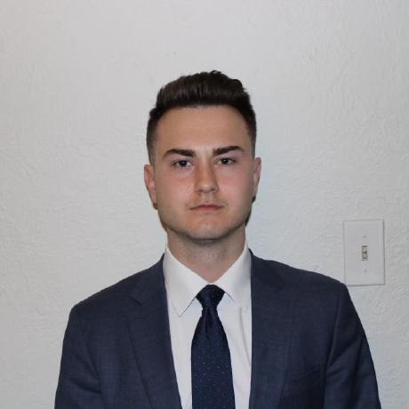

MEET OUR TEAM
Elijah Montgomery
Jason Casperson
Presidente
Chief Executive Officer
Julian Pecino
Chief Operations Officer

Slide 3
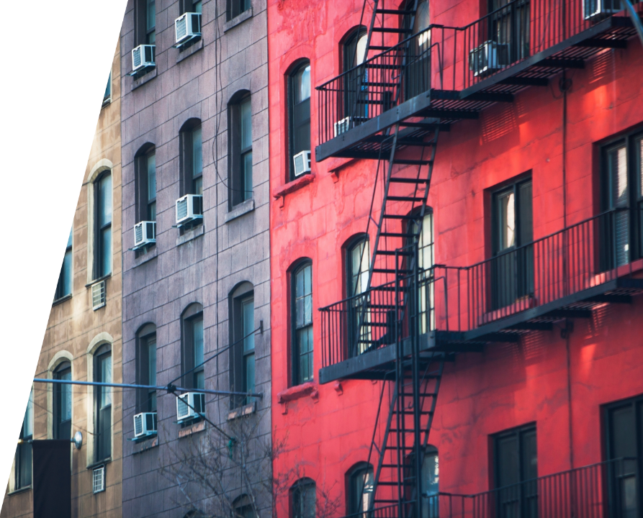
Agenda
Introduction
Building Policies
Cost of Living Comparison
Rate of Homelessness
Findings of Comparisons
Summary

Slide 4
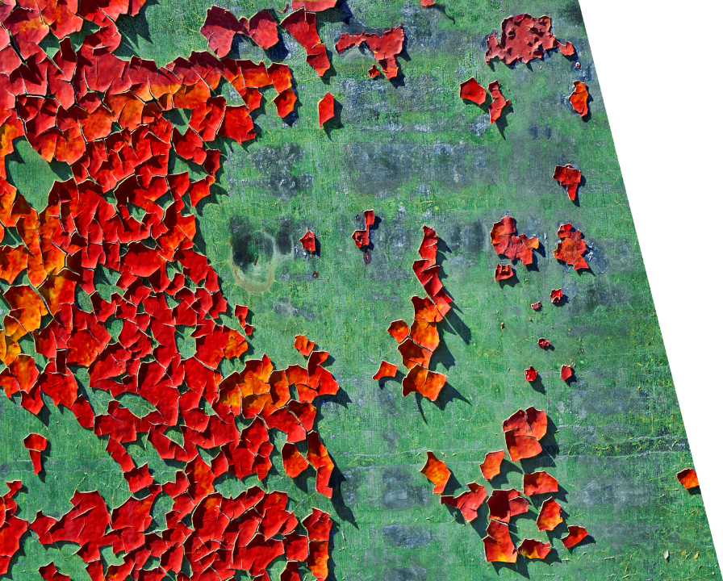
INTRODUCTION
The issue of being, or becoming homeless has always existed since ancient times. Today we are going to take a look at these same issues with a modern lens and see what are some of the factors that can drive someone to the point of losing their home. Join us as we explore what can be the cause.

Slide 5

ETL • Difficulty of finding correct data. •Cleaning the data. •Putting data into json format. •Loading into Flask
VISUALIZATION •Minor data transforming. •Hosting. •Website graphs.

Slide 6

Building & Zoning Policies
San Francisco and Austin

Slide 7
Zoning policies
City | Types of Reform | Flexibility | Affordability | Types of Zone
San Francisco | A notable example is the 2018 "Affordable Housing Bonus Program," This was met with significant community opposition. | San Francisco's rigid zoning contributes to issues like the housing crisis. | San Francisco's stringent zoning laws have made new, affordable housing developments more challenging, exacerbating affordability issues. | Both cities have diverse types of zones, but San Francisco has more specialized zones and is stricter about what can be built where.
Austin | CodeNEXT, aimed at revising the land development code to encourage more housing types and use of public transit. These efforts have faced considerable pushback. | Austin's more flexible zoning laws make it easier for the city to adapt to changing needs | Austin's focus on affordability has seen some success, thanks in part to fewer zoning restrictions | Austin, Texas, has a variety of zoning types including residential, commercial, and industrial. They have recently started pushing towards mixed-use zones as well.

Slide 8
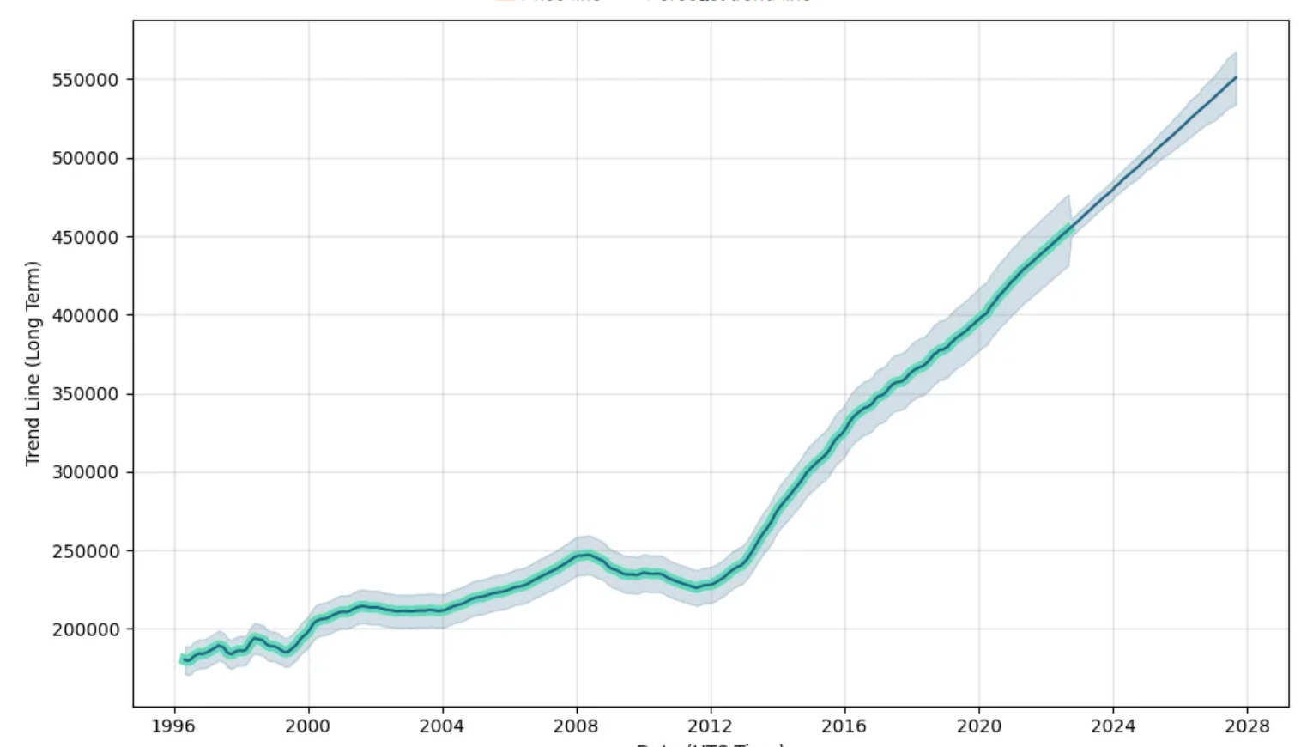
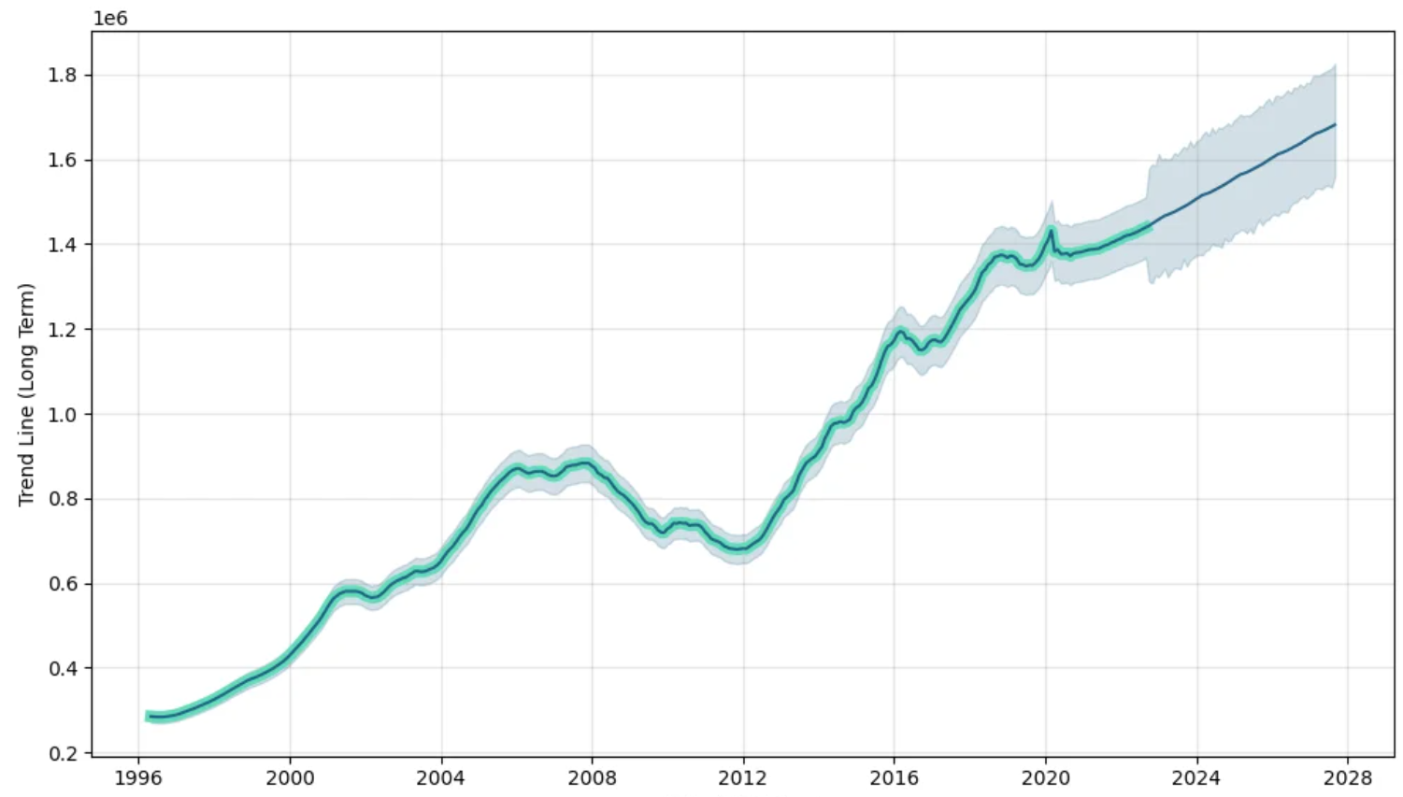
Housing index Austin Vs. San Fran
Date (UTC Time)
Date (UTC Time)

Slide 9

AREAS OF FOCUS
The Texas Legislature has dedicated $25 million to address homelessness, mental illness and substance abuse. But many cities have also adopted their own strategies, including camping bans, large shelters and citywide databases to track people experiencing homelessness.
The San Francisco Legislation on it's own allocated 1.1 billion dollars to the Homeless effort in the fiscal year of 2021 to 2022.
Capitalize on low hanging fruit to identify instances that can lead to optimal and beneficial outcomes for the homeless and good of the public.
Visualize varying degrees of density that could help locate and assist more people.

Slide 10
HOW WE GET THERE
Services
Be sure to look for any services provided to the public by the government for any assistance necessary .
Vote at your local legislative location for positive changes in policies and regulations.
location
Be sure to check and really figure out where you are in the city. It may be somewhere that is critical to survival.
Engage local authorities or churches to ask for help or assistance.
COMPASSION
Cultivate one-to-one empathy with another person's plight. Putting yourself in their shoes may shed some light and help remind you to be a better person that day.

Slide 11

SUMMARY
Navigating the Vague Path Forward
As we navigate the shadows of homelessness in Austin and San Francisco, we must acknowledge the complexity of this issue and the vague, uncertain paths that lie ahead. The homeless issue is not a monolith but a collection of stories, struggles, and aspirations. It is only through a deeper understanding of these complexities that we can hope to create a more compassionate and inclusive society where homelessness becomes a vague memory of the past.

Slide 12
THANK you, Fin.
References:
- HOMELESS IN TEXAS
A Rising Tide Drowns Unstable Boats: How Inequality Creates Homelessness
A Rising Tide Drowns Unstable Boats: How Inequality Creates Homelessness
Data Sources:
US Bureau Api
San Francisco's inflation file by month for Tuition, Medical Care, Housing, Fuel, Transportation, shelter, etc for 2010 to 2023.(500 rows per city).
Weekly Income by state or city.
interest rates data
Median Listing Price Austin-Round Rock
Median Income for all cities

